Slide 1

COMMON
ACCESSIBILITY FEATURES

Slide 2
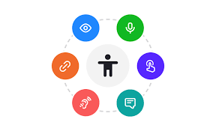
Accessibility is the practice of making information, environments, and technology meaningful and usable for as many people as possible.
It is about providing people with opportunities to use technology in the way that works for them.

Slide 3
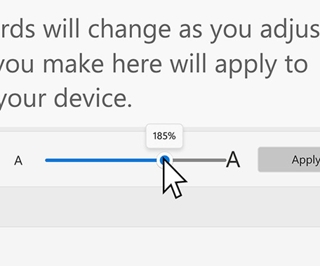
MAGNIFICATION
If you need larger text, use the Magnifier tool on Windows or the Zoom feature on Mac to enlarge the text and interface.
Examples:
Windows: Magnifier tool.
Mac: Zoom feature.

Slide 4
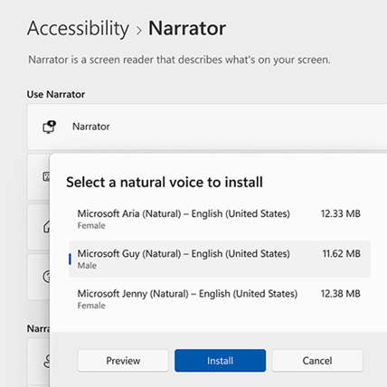
SCREEN READERS
These tools read out the text displayed on the screen. They are essential for people with vision impairments.
Examples:
Windows: Narrator.
Mac: VoiceOver.
Chrome/Firefox: Extensions like ChromeVox or NVDA
(NonVisual Desktop Access)

Slide 5

SPEECH RECOGNITION
Speech-to-text technology converts spoken words into text. It is useful for people with motor impairments or difficulty typing.
Examples:
Windows: Windows Speech Recognition.
Mac: Voice Control.
Google: Google Voice Typing.

Slide 6
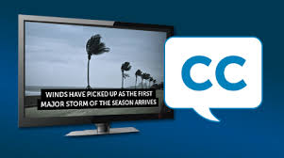
CLOSED CAPTIONS / SUBTITLES
Subtitles or captions help individuals with hearing impairments understand audio content.
Enable captions on videos and online courses to follow along with the audio.

Slide 7
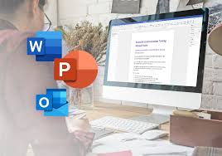
Creating Accessible Content in Word, PowerPoint, and Outlook

Slide 8
TITLE
A title is usually the first thing a screen reader will read as the highest-level heading, followed by subheadings for other sections or topics.
WORD:
To apply headings in Word, use the built-in Styles available in the Home tab of the ribbon. Depending on the hierarchy of your content, choose Heading 1, Heading 2, or Heading 3. Properly nesting the order of headings in your document is critical to informing screen reader users how to navigate. You can also modify the appearance of any heading by changing the font, size, color, or alignment.

Slide 9
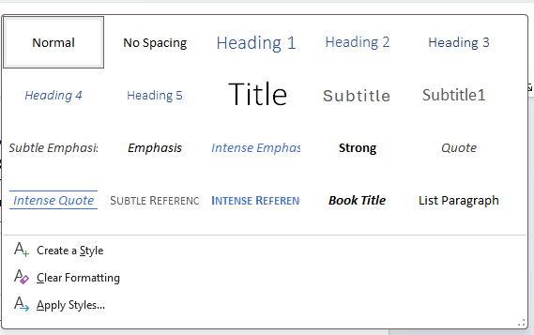

Slide 10
Add alt text to an image in Word
When you want to add alt text to an image in Word:
Right-click on an image or press the applications key and select View Alt Text. A pane will open with options.
Enter a description of the image in the Alt Text field or select Generate a description for me, and approve the AI-created alternative text.

Slide 11
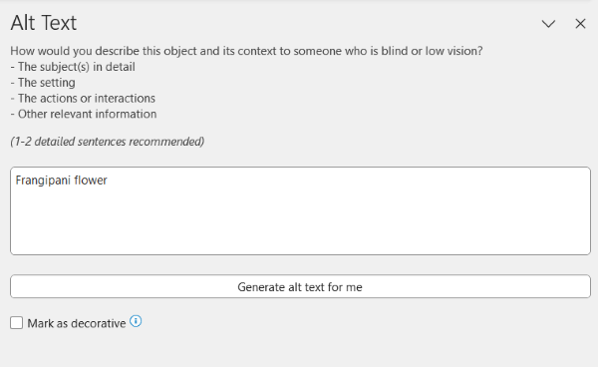

Slide 12
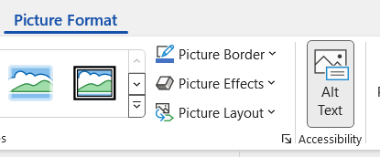
Alternatively, you can select an image and then in the ribbon, under Picture Format, select the Alt Text Then enter your alt text.

Slide 13
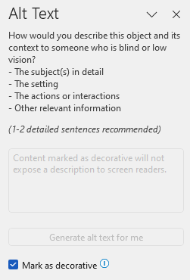
If an image doesn't convey any essential information and is simply part of the page design, select the box to mark the image as decorative.

Slide 14
Check and edit documents with Accessibility Checker
Accessibility Checker can automatically identify any issues that might make your content difficult or impossible to access. Issues could include missing alt text for images, missing slide titles, or poor color contrast.
Follow these steps to use the Accessibility Checker in Word, PowerPoint, and Outlook:
Open the document, presentation, or email that you want to check for accessibility issues. In the Review tab, select Check Accessibility.
The Accessibility Checker pane will open.

Slide 15
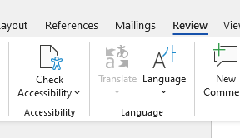

Slide 16
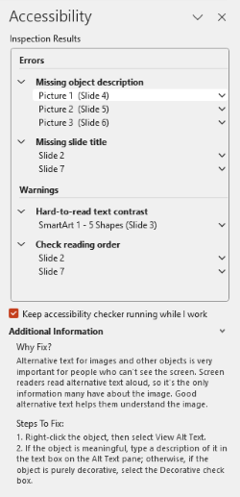
Review the list of issues and warnings that the Accessibility Checker has found.
- Errors are more severe and should be fixed as soon as possible.
- Warnings are less critical but will still affect some users.

Slide 17
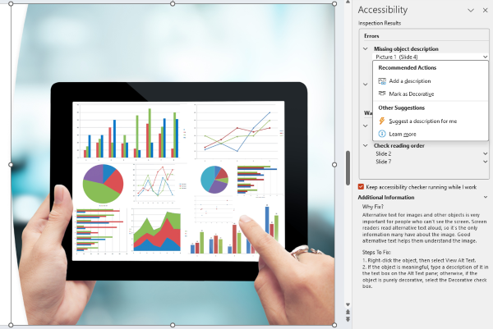
Select an issue or warning to see more details and suggestions on how to fix it.

